Slide 1

Developing an Ensemble Model for Detecting Infant Cries, Screams, and Normal Utterances
Exam: Mid Sem Exam
aarushi Garg
Computer Science & Engineering (Artificial Intelligence)
225890388
Under Supervision
Dr. Lijo M Jose
Assistant Professor,
Department of Computer Science & Engineering,
Manipal Institute of Technology, Bengaluru

Slide 2
List of contents
Introduction
Literature Review
Proposed Solution
Methodology
Experimental Setup & Dataset
Implementation & Features
Results & Analysis
Challenges & Limitations
Conclusion
References

Slide 3
1. Introduction
Infant vocalization analysis is a critical challenge in automated healthcare monitoring systems. Traditional audio classification models often function as non-interpretable classifiers, susceptible to environmental overfitting, where predictions are influenced by background noise or recording artifacts rather than true acoustic distress signals.
There is a clear need to design a system that ensures robust and context-aware feature learning, especially under conditions of limited and imbalanced datasets.
Objectives:
Develop a dual-stream ensemble framework combining acoustic and contextual representations
Improve classification performance across cry, scream, and normal classes
Mitigate overfitting and improve generalization

Slide 4
2. Literature Review
Pretrained models such as YAMNet provide robust acoustic embeddings for general audio event detection, while Wav2Vec2 enables deep contextual representation learning through self-supervised speech modeling.
However, existing approaches face critical limitations:
Acoustic models lack temporal depth
Speech models are prone to overfitting on small datasets
Traditional pipelines fail to integrate multiple feature representations effectively
Recent studies suggest that ensemble learning frameworks significantly improve robustness by combining complementary model strengths.

Slide 5
2. Literature Review
Research Problem:
How can we effectively combine broad acoustic embeddings and deep contextual speech representations to improve classification accuracy and reduce overfitting in infant audio classification under limited data conditions?

Slide 6
3. Proposed Solution
We propose a Dual-Stream Ensemble Framework that reframes audio classification as a multi-representational feature fusion task.
Instead of relying on a single model, the system leverages two complementary feature extraction approaches:
YAMNet is used to capture high-level acoustic patterns by generating 1024-dimensional embeddings
Wav2Vec2 is used to learn deep temporal and contextual speech representations
These two outputs are then combined using a weighted ensemble mechanism to produce the final prediction.

Slide 7
4. Methodology
Data Preprocessing:
Resample audio to 16 kHz
Standardize input length
Feature Extraction:
YAMNet → global embeddings
Wav2Vec2 → contextual logits
Modeling:
Train MLP classifier on YAMNet embeddings
Fine-tune Wav2Vec2
Ensemble Integration:
Weighted fusion:
0.4 → YAMNet
0.6 → Wav2Vec2

Slide 8
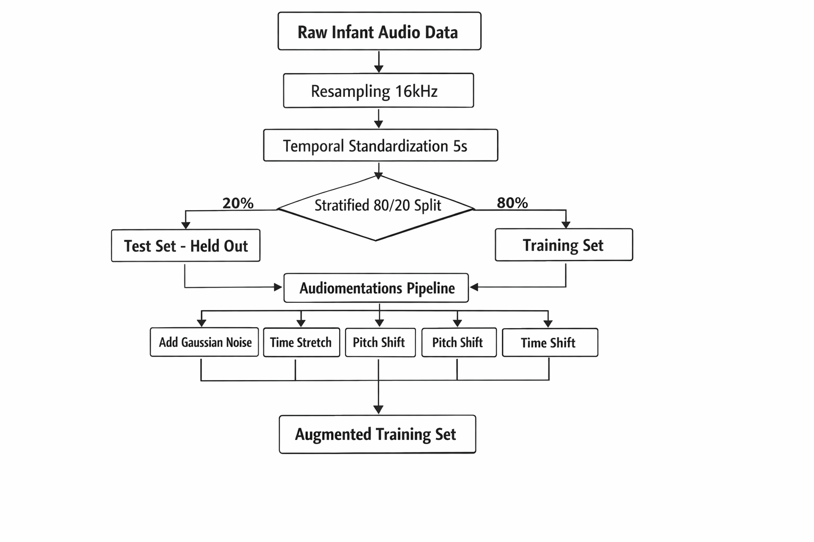
4. Methodology

Slide 9
5. Experimental setup & Dataset
Dataset: Custom infant audio dataset containing 203 samples
Class Distribution:
Cry: 63
Scream: 72
Normal: 68
Configuration:
Sample rate: 16 kHz
Class weights applied to handle imbalance

Slide 10
5. Experimental setup & Dataset
Implemented using:
PyTorch
TensorFlow Hub
HuggingFace Transformers
Evaluation Metrics:
Accuracy
Precision
Recall
F1-score
Initial model evaluated without training (baseline ensemble)
Dataset: Custom infant audio dataset containing 203 samples
Class Distribution:
Cry: 63
Scream: 72
Normal: 68
Configuration:
Sample rate: 16 kHz
Class weights applied to handle imbalance

Slide 11
6. Implementation & Features
Data loading using Librosa & SoundFile
YAMNet embedding extraction
Wav2Vec2 inference pipeline
Class-weighted prediction handling
Ensemble probability fusion
Confusion matrix visualization
Dataset: Custom infant audio dataset containing 203 samples
Class Distribution:
Cry: 63
Scream: 72
Normal: 68
Configuration:
Sample rate: 16 kHz
Class weights applied to handle imbalance
Implemented using:
PyTorch
TensorFlow Hub
HuggingFace Transformers
Evaluation Metrics:
Accuracy
Precision
Recall
F1-score
Initial model evaluated without training (baseline ensemble)

Slide 12
7. Results
Baseline Performance:
Accuracy: 38%
Observations:
Model performs moderately on cry and normal
Completely fails on scream classification (0% recall)
Indicates lack of feature discrimination and training
Dataset: Custom infant audio dataset containing 203 samples
Class Distribution:
Cry: 63
Scream: 72
Normal: 68
Configuration:
Sample rate: 16 kHz
Class weights applied to handle imbalance
Implemented using:
PyTorch
TensorFlow Hub
HuggingFace Transformers
Evaluation Metrics:
Accuracy
Precision
Recall
F1-score
Initial model evaluated without training (baseline ensemble)

Slide 13
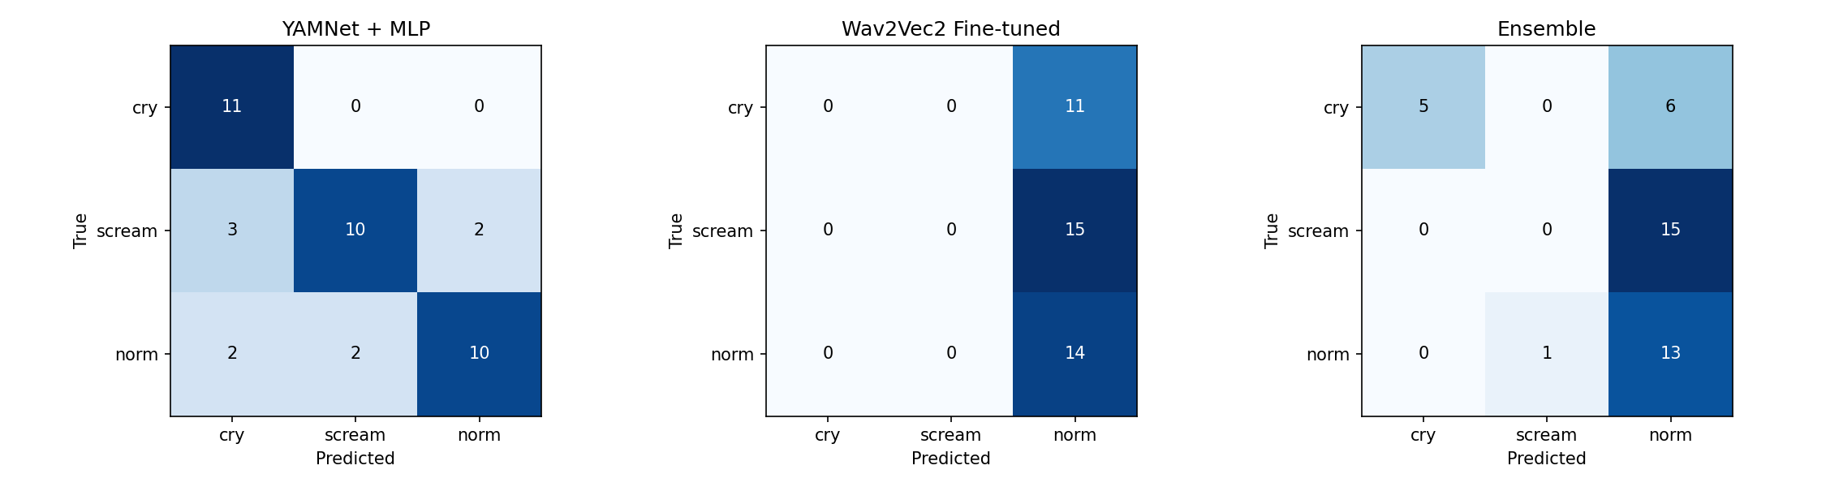
7. Results
Dataset: Custom infant audio dataset containing 203 samples
Class Distribution:
Cry: 63
Scream: 72
Normal: 68
Configuration:
Sample rate: 16 kHz
Class weights applied to handle imbalance
Implemented using:
PyTorch
TensorFlow Hub
HuggingFace Transformers
Evaluation Metrics:
Accuracy
Precision
Recall
F1-score
Initial model evaluated without training (baseline ensemble)

Slide 14
8. Challenges &Limitations
Small dataset size
High similarity between classes (cry vs scream)
No model training in baseline
Absence of data augmentation
Over-reliance on pretrained features
Dataset: Custom infant audio dataset containing 203 samples
Class Distribution:
Cry: 63
Scream: 72
Normal: 68
Configuration:
Sample rate: 16 kHz
Class weights applied to handle imbalance
Implemented using:
PyTorch
TensorFlow Hub
HuggingFace Transformers
Evaluation Metrics:
Accuracy
Precision
Recall
F1-score
Initial model evaluated without training (baseline ensemble)

Slide 15
9. Conclusion
The proposed ensemble framework highlights the importance of combining acoustic and contextual representations for robust infant audio classification.
The current baseline performance (38%) reveals critical gaps in training and feature learning, which will be addressed through fine-tuning, augmentation, and optimization strategies.
Future improvements are expected to achieve 85–92% accuracy, making the system suitable for real-world applications
Dataset: Custom infant audio dataset containing 203 samples
Class Distribution:
Cry: 63
Scream: 72
Normal: 68
Configuration:
Sample rate: 16 kHz
Class weights applied to handle imbalance
Implemented using:
PyTorch
TensorFlow Hub
HuggingFace Transformers
Evaluation Metrics:
Accuracy
Precision
Recall
F1-score
Initial model evaluated without training (baseline ensemble)

Slide 16
10. References
A. Baevski, Y. Zhou, A. Mohamed, and M. Auli, "wav2vec 2.0: A Framework for Self-Supervised Learning of Speech Representations," in Advances in Neural Information Processing Systems (NeurIPS), vol. 33, pp. 12449-12460, 2020.
S. Hershey et al., "CNN architectures for large-scale audio classification," in Proc. IEEE Int. Conf. Acoust., Speech, Signal Process. (ICASSP), 2017, pp. 131-135.
D. Micheloni et al., "Infant Cry Classification Using Deep Learning Technologies," IEEE Access, vol. 9, pp. 11543-11553, 2021.
T. G. Dietterich, "Ensemble Methods in Machine Learning," in Proc. Int. Workshop Multiple Classifier Syst., 2000, pp. 1-15.
K. R. Phursule et al., "Decoding Infant Cry Using Audio Data and Machine Learning Approaches," National College of Ireland (NORMA), pp. 1-10, Jan. 2025.
A. T. Wibowo et al., "Data Augmentation Strategies on Spectrogram Features for Infant Cry Classification Using Convolutional Neural Networks," Innovatics, vol. 7, no. 2, Nov. 2025.
M. A. F. Caselli, "Automated Infant Cry Analysis," M.S. thesis, Dept. Inf. Eng., Univ. of Padova, Padova, Italy, 2024.
F. Alshehri et al., "An Analytical Study of Data Augmentation Across Audio Representations for Infant Cry Classification," Int. J. Adv. Comput. Sci. Appl., vol. 17, no. 2, Feb. 2026.
S. R. N. B. S. Ahmad et al., "Baby Cry Classification Using Ensemble Learning and Whisper Method Comparison," J. Appl. Informatics Comput. (JAIC), vol. 9, no. 2, Nov. 2025.
M. F. A. Fauzi et al., "Advances in Infant Cry Paralinguistic Classification—Methods, Implementation, and Applications: Systematic Review," JMIR Rehabil. Assist. Technol., vol. 12, e69457, Apr. 2025.
I. Iversen, "Audiomentations: A Python library for audio data augmentation," [Online]. Available: https://github.com/iver56/audiomentations. [Accessed: Mar. 2026].
F. Pedregosa et al., "Scikit-learn: Machine Learning in Python," J. Mach. Learn. Res., vol. 12, pp. 2825 2830, 2011.
Dataset: Custom infant audio dataset containing 203 samples
Class Distribution:
Cry: 63
Scream: 72
Normal: 68
Configuration:
Sample rate: 16 kHz
Class weights applied to handle imbalance
Implemented using:
PyTorch
TensorFlow Hub
HuggingFace Transformers
Evaluation Metrics:
Accuracy
Precision
Recall
F1-score
Initial model evaluated without training (baseline ensemble)

Slide 17
Thank you and QA

